Slide 1

WORKSHOP #1

Slide 2
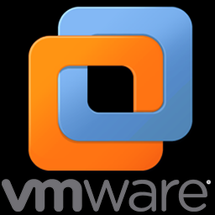
Agenda
History
What is it and what is it for.
Server options available in the market (free and paid)
Advantages and disadvantages of virtualization.
Showing a functional demo to the class.
Installation requirements.
Important points during installation and configuration.

Slide 3
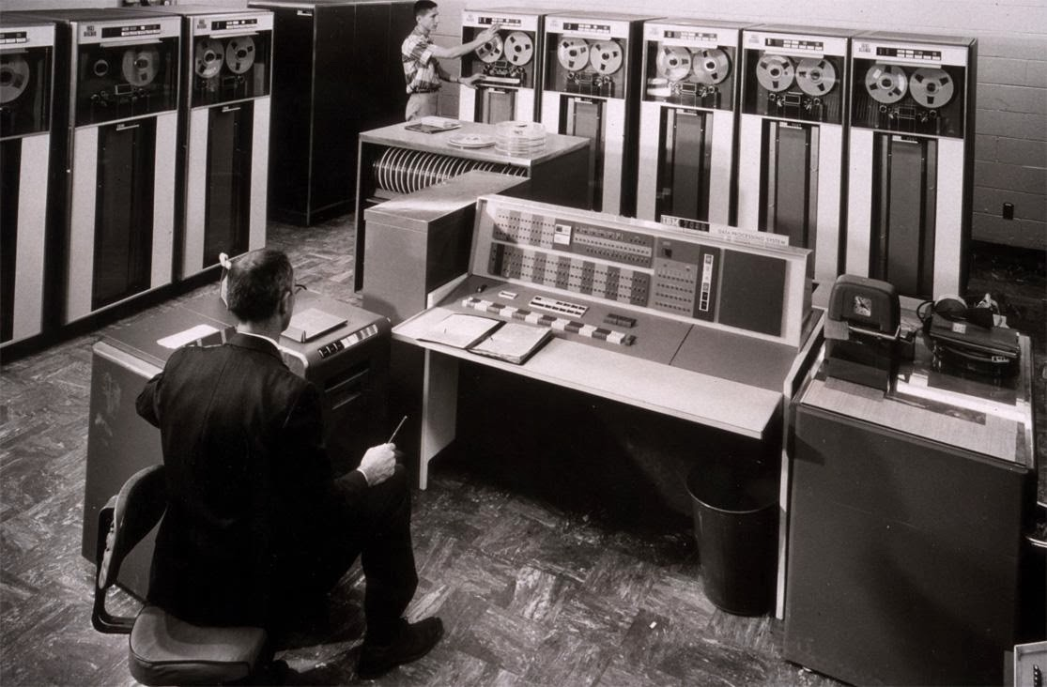
History
Virtualization is a technology that was developed by IBM in the 60s. The first computer designed specifically for virtualization was the IBM S / 360 Model 67 mainframe.

Slide 4
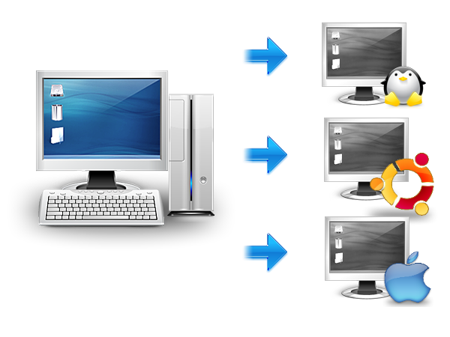
What is virtualization?
Virtualization is the process of creating a software-based (or virtual) representation, rather than a physical one. Virtualization can be applied to servers, applications, storage and networks, and is the most effective way to reduce IT costs and increase the efficiency and agility of any size business.

Slide 5
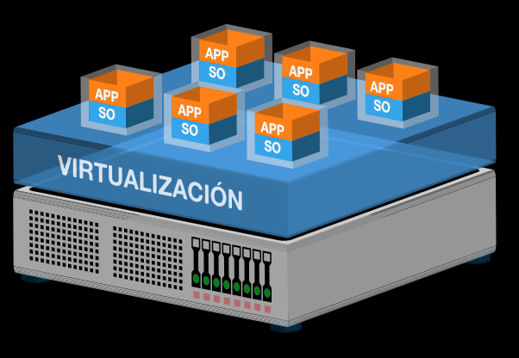
What is it for ?
For developers: using this technology it is possible to install different operating systems, security patches, own or third-party developments.
In production environments: useful to ensure business continuity taking advantage of downtime.
Centralize: thanks to virtualization it is possible to carry out prevention activities, such as backups, from the virtual machine manager.
Redistribute resources from physical servers.
Hardware Emulators: Replace workstations with silly terminals.

Slide 6
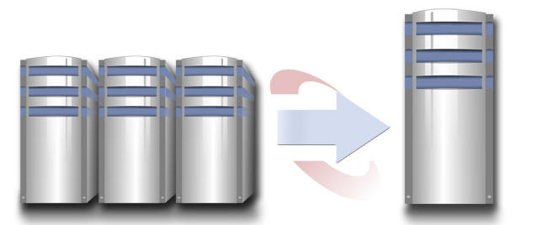
Advantage
Rapid incorporation of new resources for virtualized servers.
Reduction of space and consumption costs.
Reducing IT costs through increased efficiency and flexibility in the use of resources.
Centralized and simplified global administration.
It allows us to manage our CPD as a pool of resources or pool all the processing capacity, memory, network and storage available in our infrastructure
It not only brings the direct benefit in reducing the necessary hardware, as well as its associated costs
Reduces stopping times
High degree of overall satisfaction

Slide 7
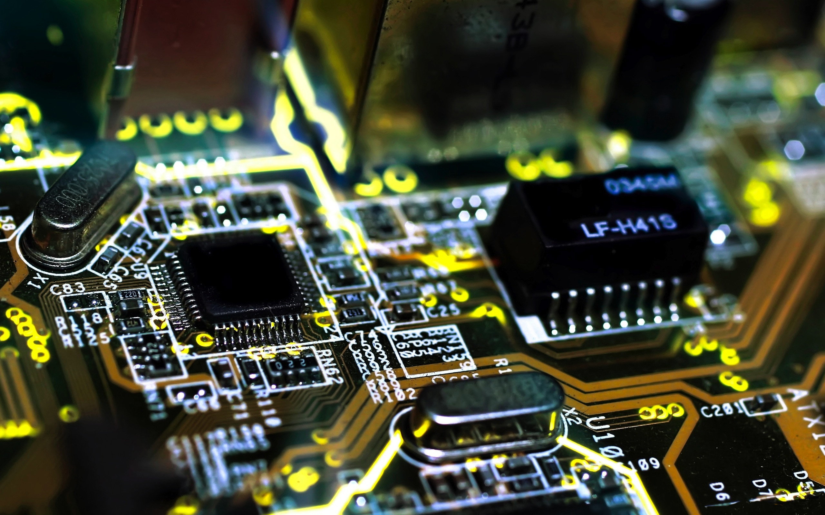
Disadvantages
Increase of initial costs
Investment in software to manage servers.
Need to learn how to handle the new virtual environment.
Lower performance

Slide 8
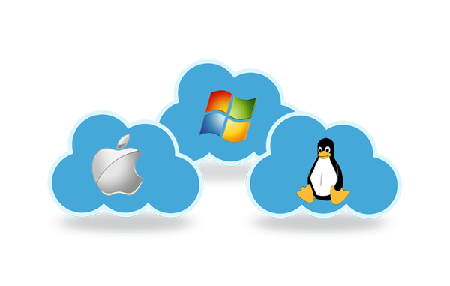
Operating systems for servers.

Slide 9
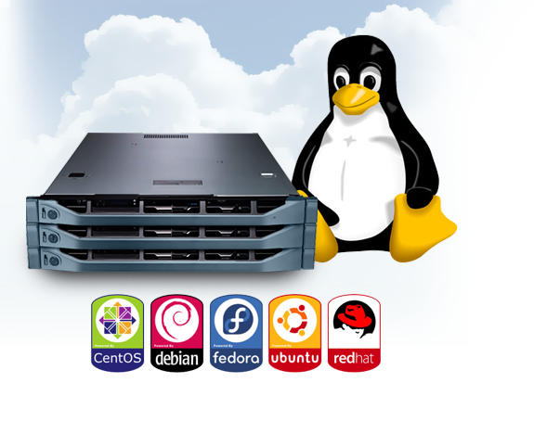
LINUX
Best cost of the market, free or a symbolic price for the cd.
• Huge amount of free software.
• Greater stability for something they use in high performance servers.

Slide 10

Windows
It has the most software developed.
Most viruses are made to win You may have compatibility errors in new systems.
New versions require many resources
Windows 2000.
Windows 2000 Server
Windows Server 2003.
Windows Server 2008.
Windows Server 2008 R2.
Windows Server 2012.
Windows Server 2016.
Windows Small Business Server
Windows Essential Business Server
Windows Home Server.

Slide 11
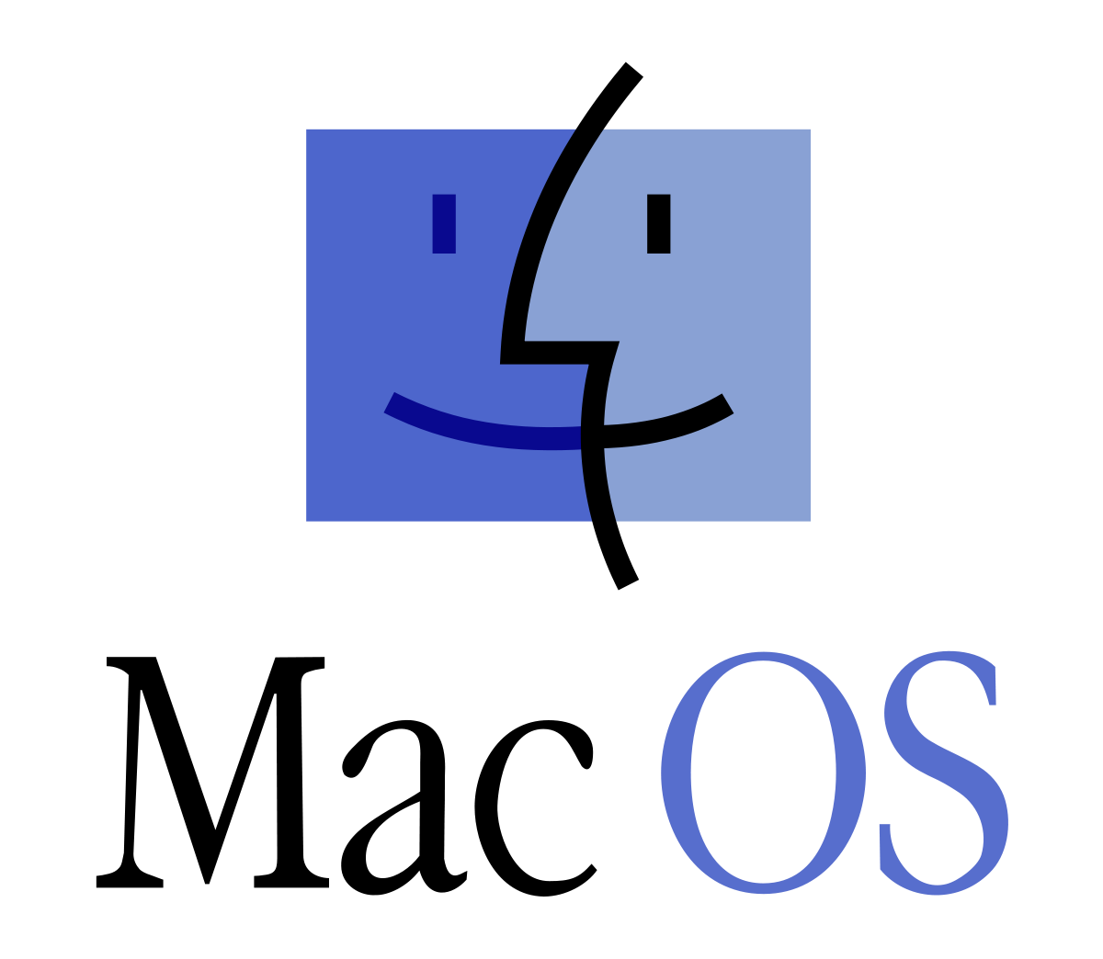
MAC
Best graphical interface on the market
It is very stable
It is less vulnerable to viruses and malware
Mac OS X Server 10.0 (Cheetah Server)
Mac OS X Server 1.0 (Rhapsody
Mac OS X Server 10.1 (Puma Server)
Mac OS X Server 10.2 (Jaguar Server)
Mac OS X Server 10.3 (Panther Server)
Mac OS X Server 10.4 (Tiger Server)
Mac OS X Server 10.5 (Leopard Server)
Mac OS X Server 10.6 (Snow Leopard Server)
Mac OS X 10.7 (Lion Server)
Mac OS X 10.8 (Mountain Lion Server)

Slide 12
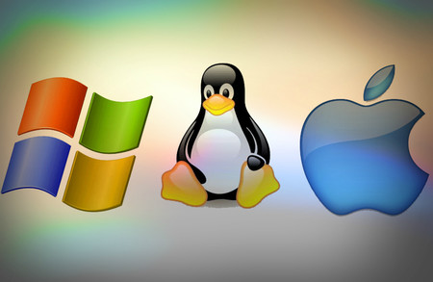
S.O
Unix | Windows | MAC
support Multi-user | Graphical user interface | price of about 150 euros (payment and owner).
Multi-tasking | Multitasking | only works on the computers that the same company manufactures.
Portability | Possibility of integrating multimedia resources | stability
Powerful development tools | Tool for networking | security
Stability | Incorporating important programs | freedom from viruses.
Speed
Dynamic shared libraries

Slide 13

TOOLS

Slide 14
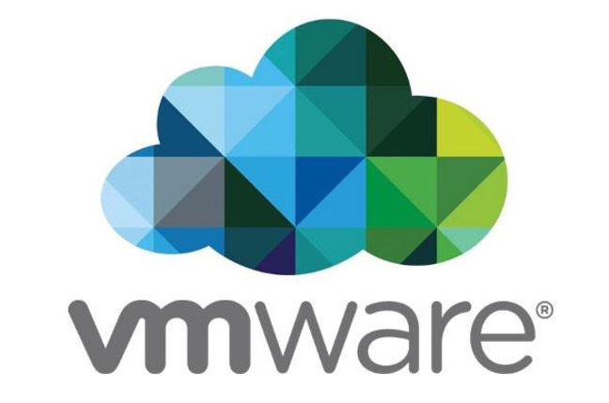
VMware ESXi Server is computer virtualization software developed by VMware Inc. The ESXi Server is an advanced, smaller-footprint version of the VMware ESX Server, VMware's enterprise-level computer virtualization software product. Implemented within the VMware Infrastructure.

Slide 15

Ubuntu Server is a part of the larger set of Ubuntu products and operating system developed by Canonical Ltd. Ubuntu server is a specific addition that differs a little bit from Ubuntu desktop, in order to facilitate installation on servers.

Slide 16
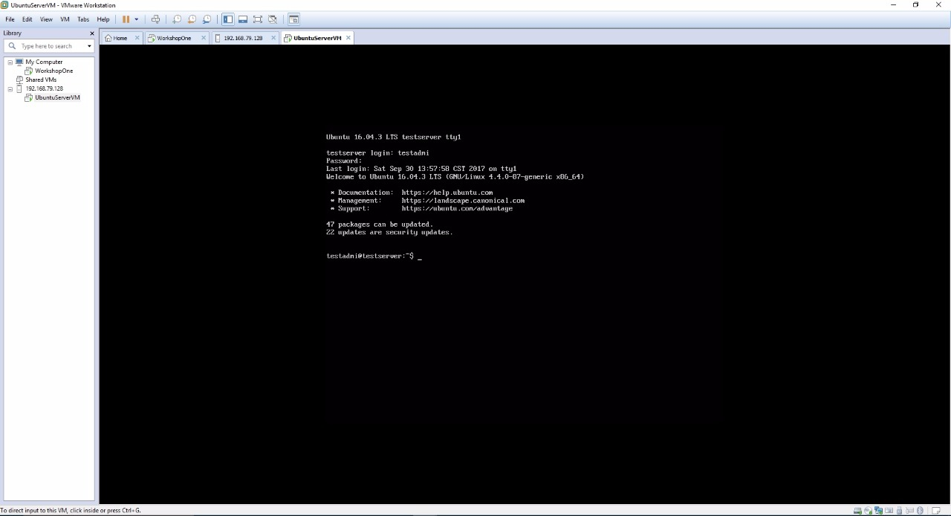
It is the console of the virtual server.

Slide 17
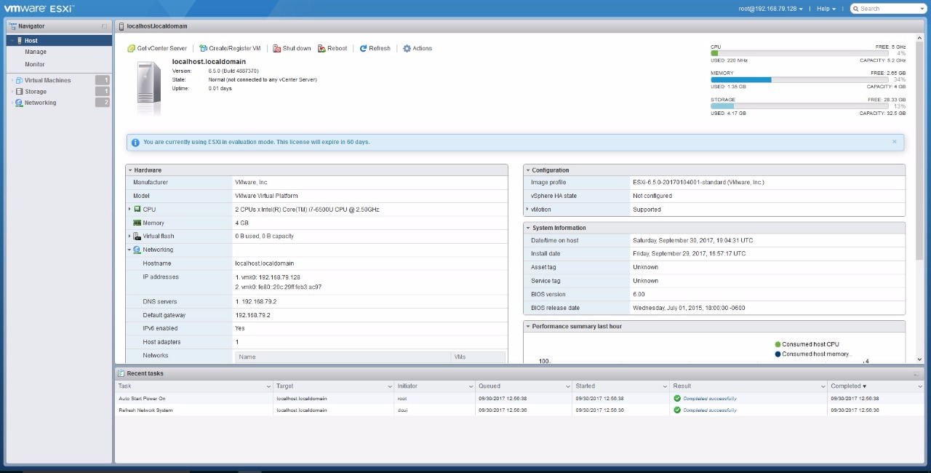
Start view of the web client.

Slide 18
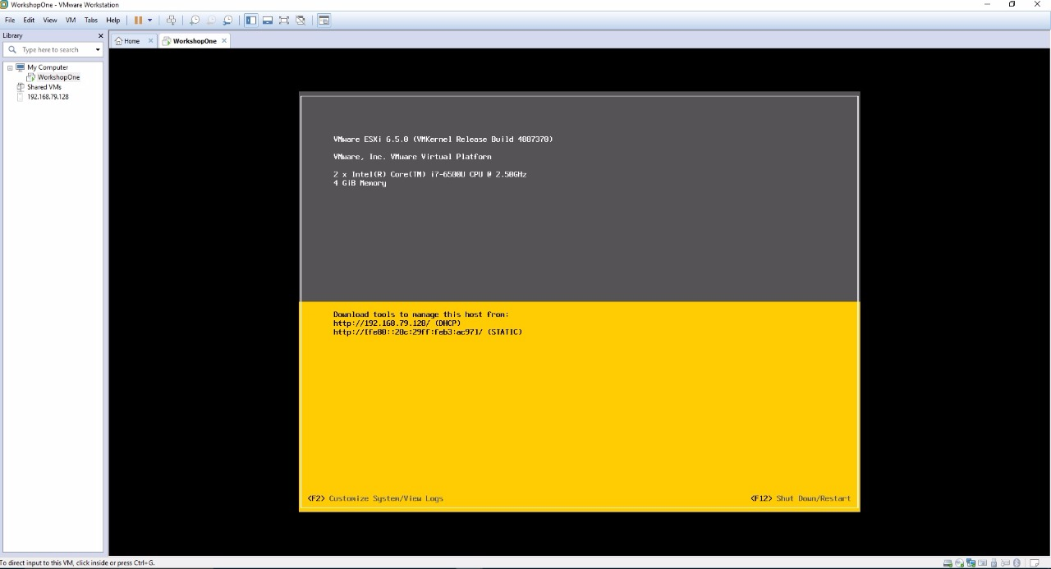
This is the ESXi already installed. In the yellow part two IP addresses are displayed. They are for going to the web client. If the ESXi is not turned on, the client can not be opened.

Slide 19
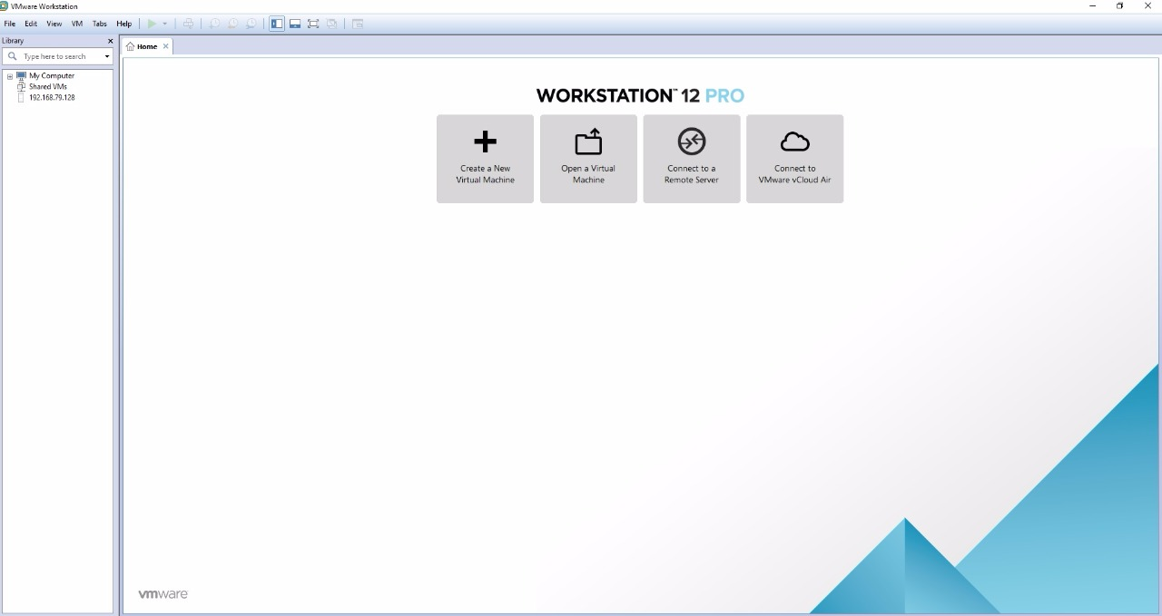
Is the image or the start of the VMware virtual machine

Slide 20
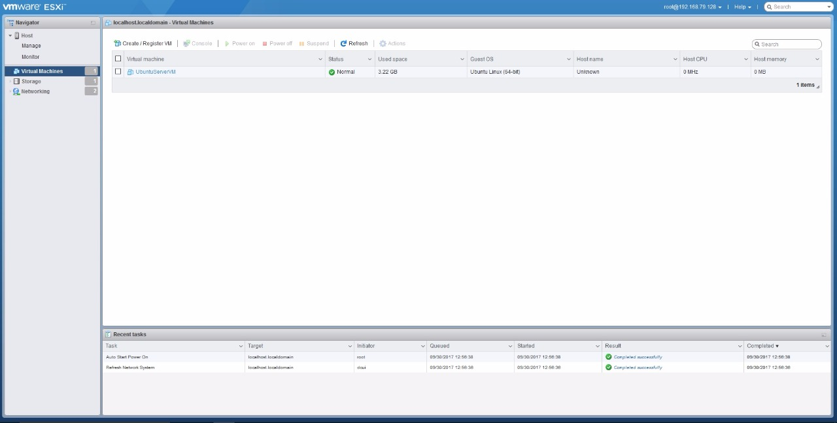
This image is where the virtual machines created with the ESXi are viewed from the web client.

Slide 21
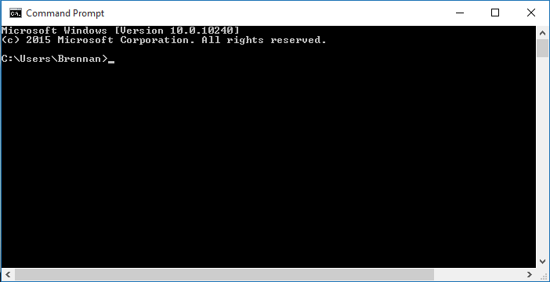
Connection
Ubuntu Server
and
WINDOWS 10.

Slide 22
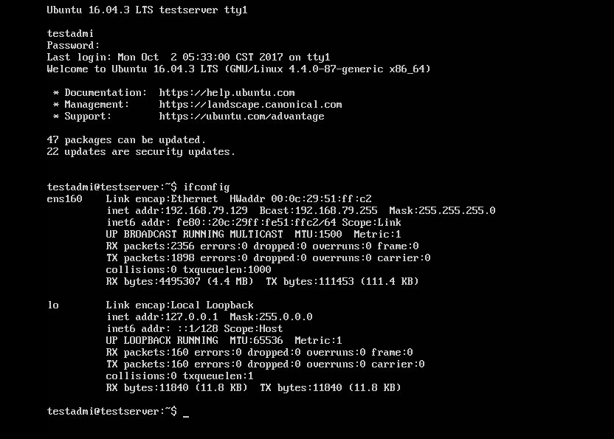

Slide 23
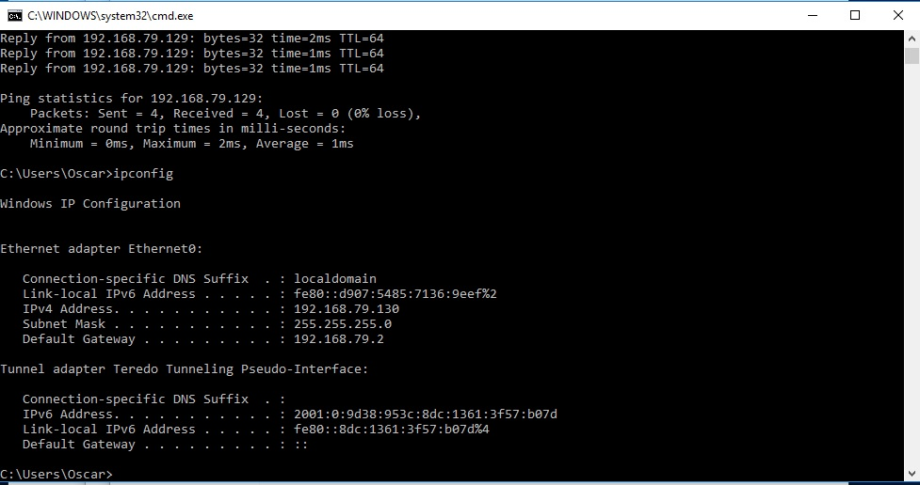

Slide 24


WorkShop #1 Virtualization.
Oscar Vega.
Kevin Arias.
Roque Chacón.

